Slide 1

Absenteeism Prediction System
Transparent, Fair, and Explainable Machine Learning for HR Decision-Making
Team:
Krishna Kumar Bais (241110038)
Rohan (241110057)

Slide 2
Problem Framing
Why this problem?
Absenteeism affects productivity, planning, and workforce allocation. Organizations want predictive tools but MUST ensure:
Transparency
Fairness
Interpretability
Ethical HR decision support
Dataset Used
740 records, 21 features
36 employees, no missing values
Target: Absenteeism time in hours
Bias issues found in age, education, service time distributions
Goal: Build a fairness-aware, explainable, usable ML system to support informed HR decisions.

Slide 3
Project Overview
End-to-End Pipeline
01
02
Data Analysis + Bias Detection
Model Development (Linear Regression)
03
04
Fairness Evaluation + Mitigation
UI Development (React + Material UI)
05
06
Explainability Integration (SHAP, LIME, Counterfactuals)
Usability Evaluation (Think-Aloud + Observations)

Slide 4
Dataset Bias Findings
Representation Bias
Education Level 1 = 82.6% (dominant)
1
Education Level 4 = 0.5% (rare)
31–40 age = 57% (over-represented)
50+ age = 1.2% (under-represented)
Disproportionate Effects
2
50+ age group → 29.11 hours absenteeism (high deviation)
Education levels show structured differences in absenteeism patterns
Sources of Bias
3
Sampling bias (single company)
Historical bias in absence records
Inconsistent labelling of reasons

Slide 5
Model & Fairness Mitigation
Baseline Model: Linear Regression
Chosen for:
Interpretability
Coefficient transparency
Fast training
Bias Mitigation Applied
Removed proxy features (Height, Weight, BMI, ID)
Age balancing (equal samples for all age groups)
Education balancing
Re-sampling to equalize group sizes
Effect: Dataset reduced from 740 → 34 samples after balancing.

Slide 6
Performance Comparision
Metric
Baseline
After Mitigation
Change
RMSE
11.43
43.12
↑ Worsened
MAE
6.44
16.50
↑ Worsened
R²
-0.20
-0.09
Slight improvement
Key Insight: Fairness improved, but cost was massive performance degradation due to extreme balancing on a very small dataset.

Slide 7
UI Design & Key Screens
Target Users
HR professionals
Managers
Senior decision-makers
UI Decisions
React + Material UI → professional workplace interface
Logical grouping of input fields (Demographics, Work Info etc.)
Progressive disclosure (collapsible panels)
Clear visual hierarchy
Design Goals
Reduce cognitive load
Support transparency
Allow non-technical users to interpret predictions

Slide 8
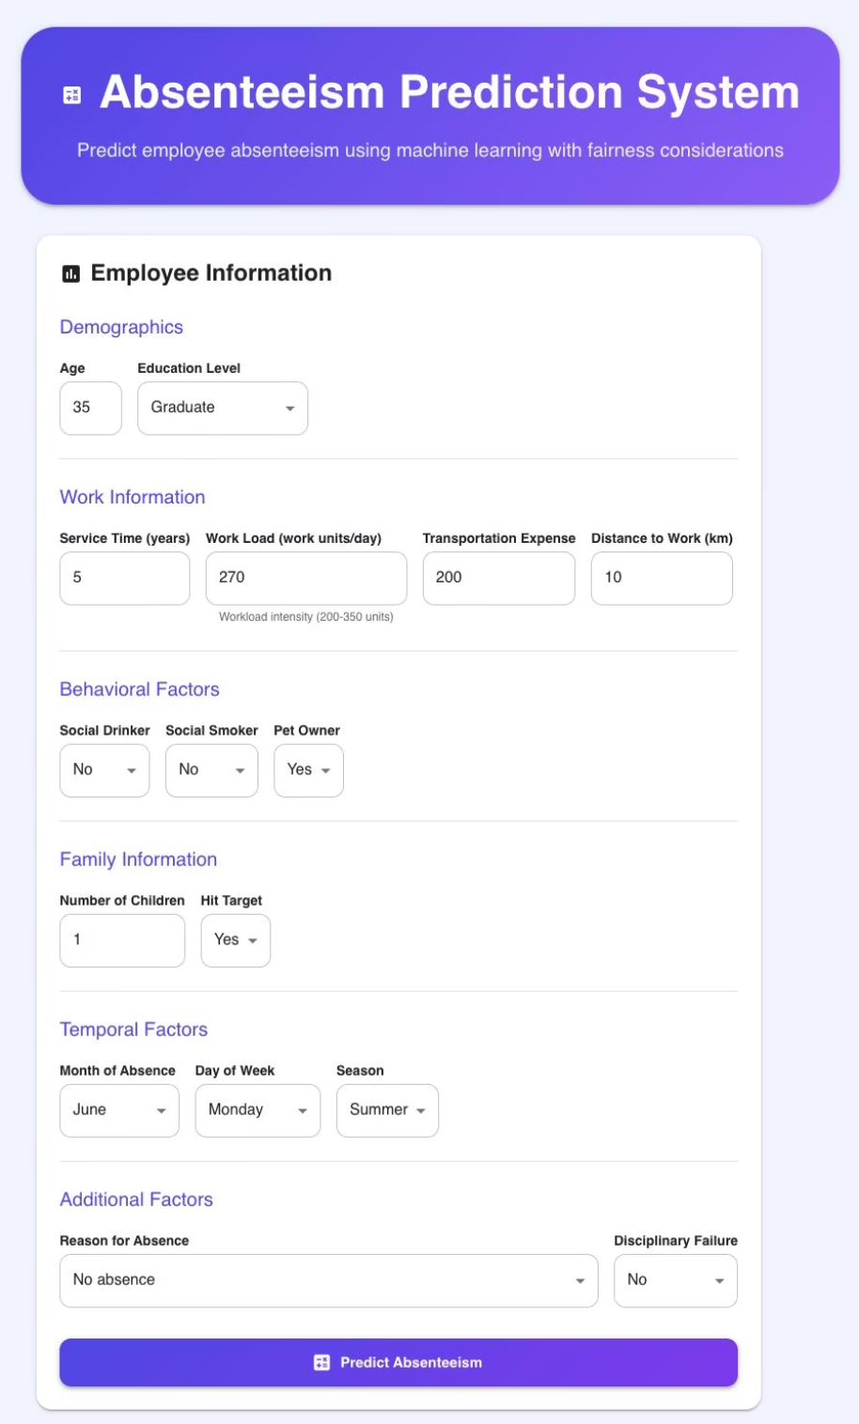
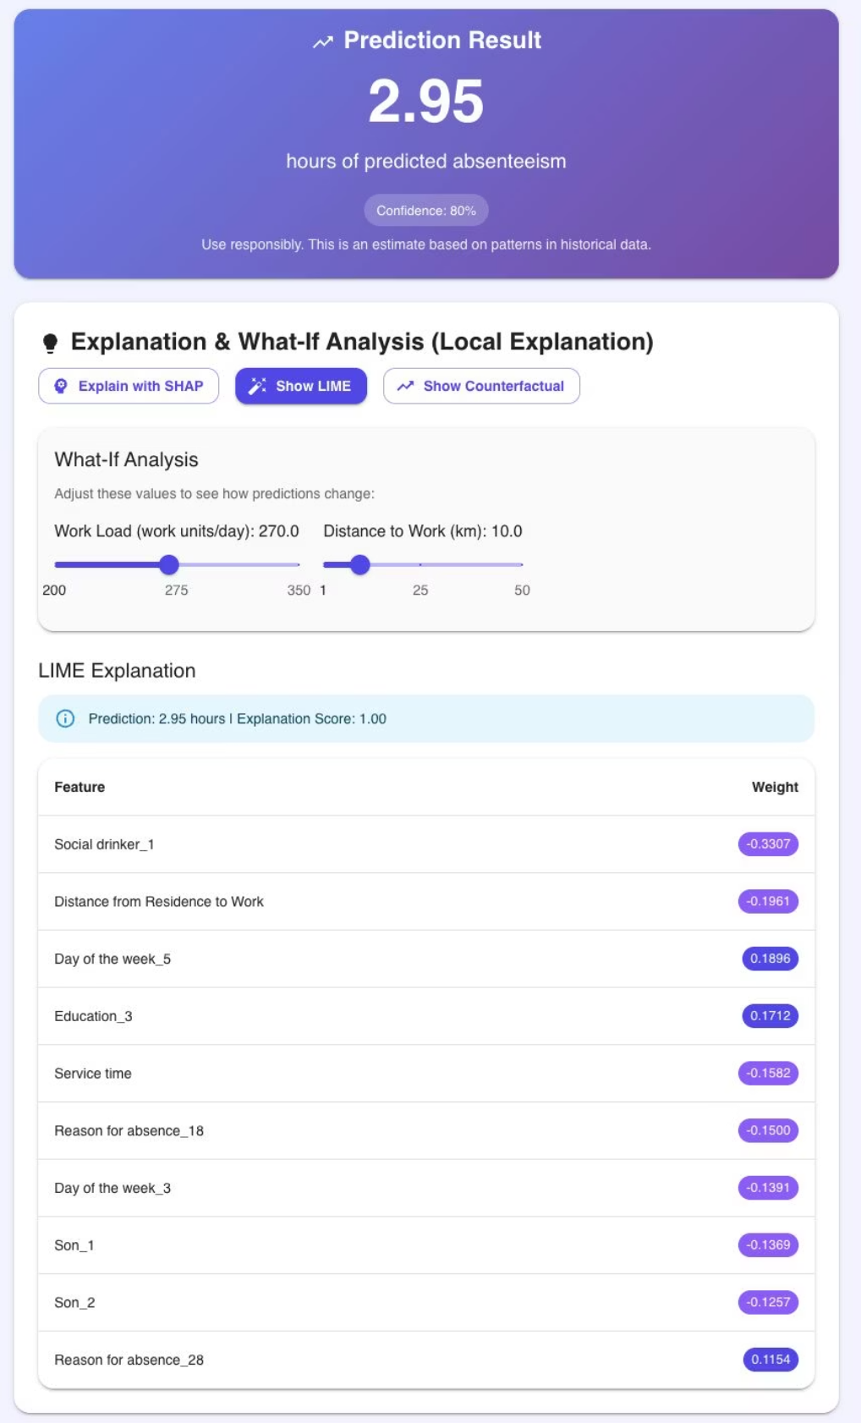
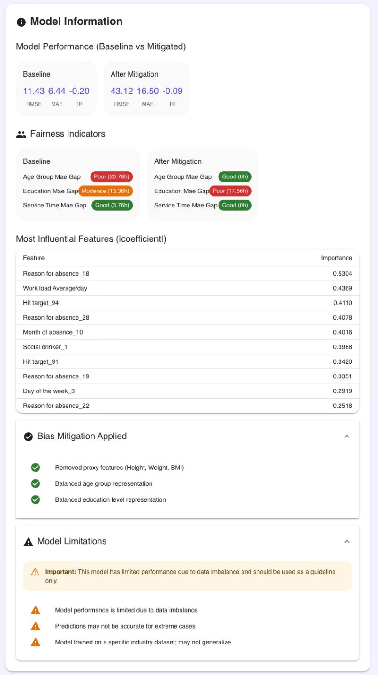
Key Screens

Slide 9
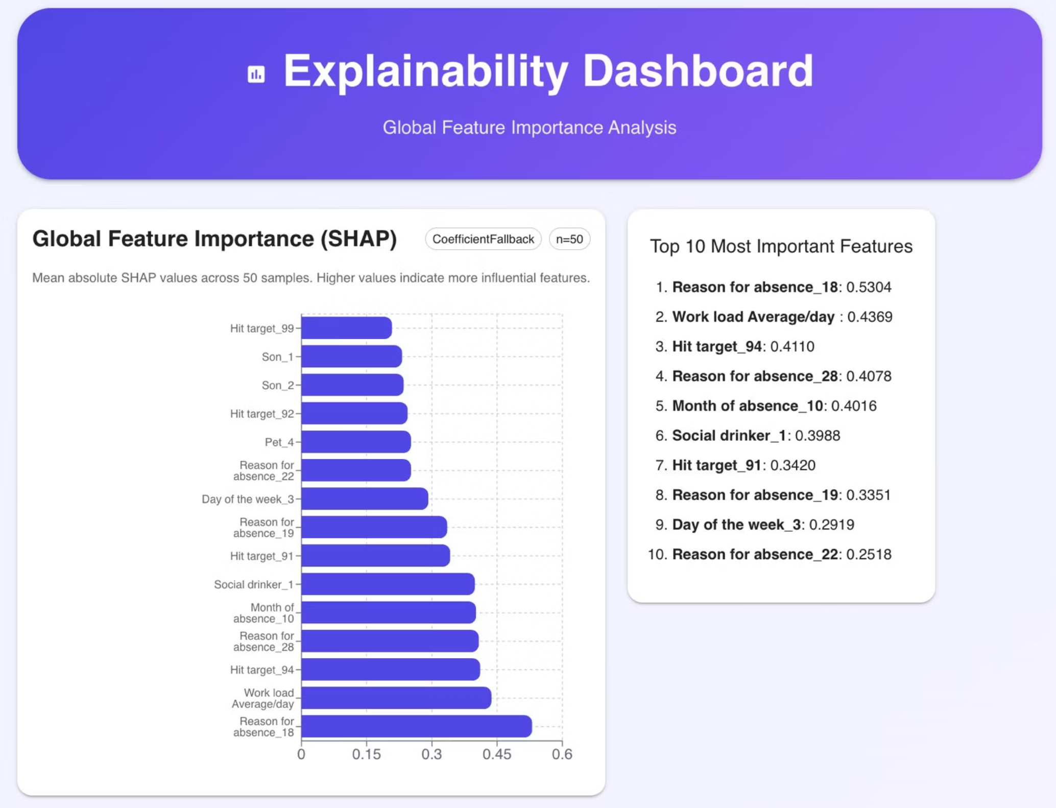

Slide 10

Explainability Integration
SHAP
LIME
Counterfactual Explanations
Game-theoretic feature importance, consistent and mathematically grounded. Used for global importance charts and local attributions.
Local surrogate linear model. "Why did the model predict this for this employee?" Sparse, easy-to-understand explanation.
"What should change to reduce absenteeism?" Actionable (workload, social habits, etc.). Provides slider-based scenario suggestions.
Global Explanation
Top features (mean absolute SHAP value):
Reason for absence
Workload
Hit Target
Month of absence
Social drinker

Slide 11
Evaluation Methodology & Findings
Methods Used
1
Think-Aloud Protocol
Usability testing with observations
Total: 5 participants
2
Tasks
Fill prediction form
Interpret result
Understand SHAP & LIME
Motivation
3
Use counterfactuals
Reveals mental models
Interpret fairness panel
Captures misunderstandings
Shows explainability comprehension

Slide 12
UI Issues Identified
Confusing labels ("Hit Target", "Temporal Factors")
Units unclear (workload, distance)
Too much empty screen space
Collapsible sections ignored by some users
Slow explainability loading reduced trust
Representative Quotes
"Why is Hit Target under Family information?"
"This screen has a lot of empty space."
"What is LIME or SHAP supposed to mean?"

Slide 13
Other Issues
Explainability Issues
Users didn't understand SHAP, LIME and Counterfactuals without explanation
Wanted simple text definitions
Needed clearer link between feature contribution → actionability
Trust Issues
Poor performance metrics reduced trust
Fairness metrics not intuitive
Explanation loading delays

Slide 14
Improvements
1
UI Improvements
2
Explainability Improvements
3
Performance Improvements
Clarify labels and input units, use full-width layout, add tooltips and inline definitions, improve discoverability of collapsible sections
SHAP/LIME short descriptions near outputs, example-based explanations, better counterfactual feasibility scoring
Asynchronous explanation computation, better SHAP caching strategy, pre-computed global explanations
Reflections
What Worked
Limitations
Future Work
Think-Aloud gave deep insights
Small sample size
Add batch predictions
Observational notes revealed consistent patterns
No expert review
Improve model accuracy
No HR personas or actual HR while usability testing
Replace Linear Regression with more robust explainable models
Explainability features were appreciated once understood
Expand dataset and reduce sampling bias

Slide 15
Contributions
Krishna Kumar Bais (241110038)
Rohan (241110057)
Bias detection & fairness metrics
Data preprocessing & feature engineering
Performance vs fairness evaluation
UI/Frontend development (React + MUI)
UI/Frontend development (React + MUI)
Integration of SHAP, LIME, Counterfactuals
Usability Evaluation
Usability Evaluation

Slide 16

Thank You

